Slide 1

Rockbuster Online Rental Service
Data Analytics Team
Drew Smith

Slide 2
Project Overview
Situation
Rockbuster is a movie rental company with stores around the world but is facing stiff competition from big streaming services like Netflix and Amazon Prime
Rockbuster plans to start their own online rental service to remain competitive with large streaming companies
Objective
Find helpful insights for Rockbusters new online rental service to keep up with popular streaming services and ensure success
Key Questions
Which movies contributed the most/least to revenue gain?
What was the average rental duration for all videos?
Which countries are Rockbuster customers based in?
Where are customers with a high lifetime value based?
Do sales figures vary between geographic regions?

Slide 3
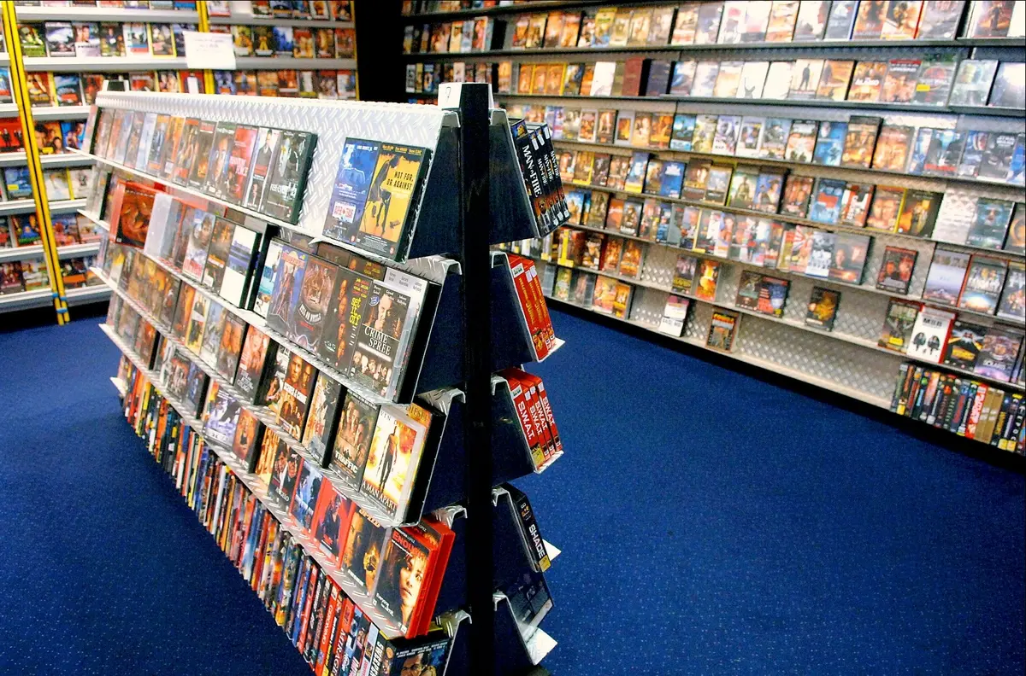
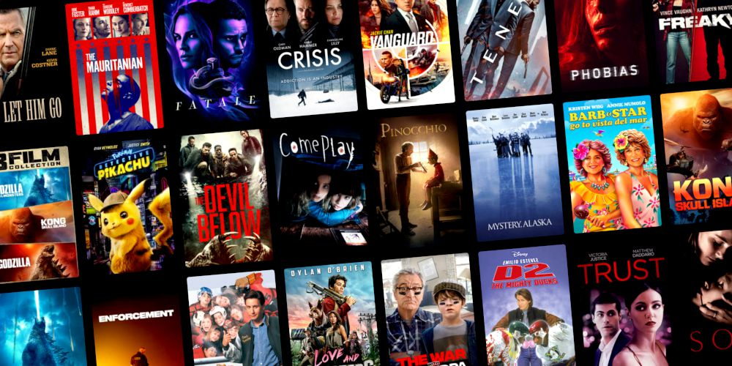
Rental Duration
Max: 7 days
Min: 3 days
Rental Rate
Min: $0.99
Max: $4.99
Movie Length
Min: 46 min
Max: 185 min
Replacement Cost
Avg: $19.98
Min: $9.99
Max: $29.99
Avg: 115 min
Avg: $3
Avg: 5 days
Movie Descriptive Statistics

Slide 4
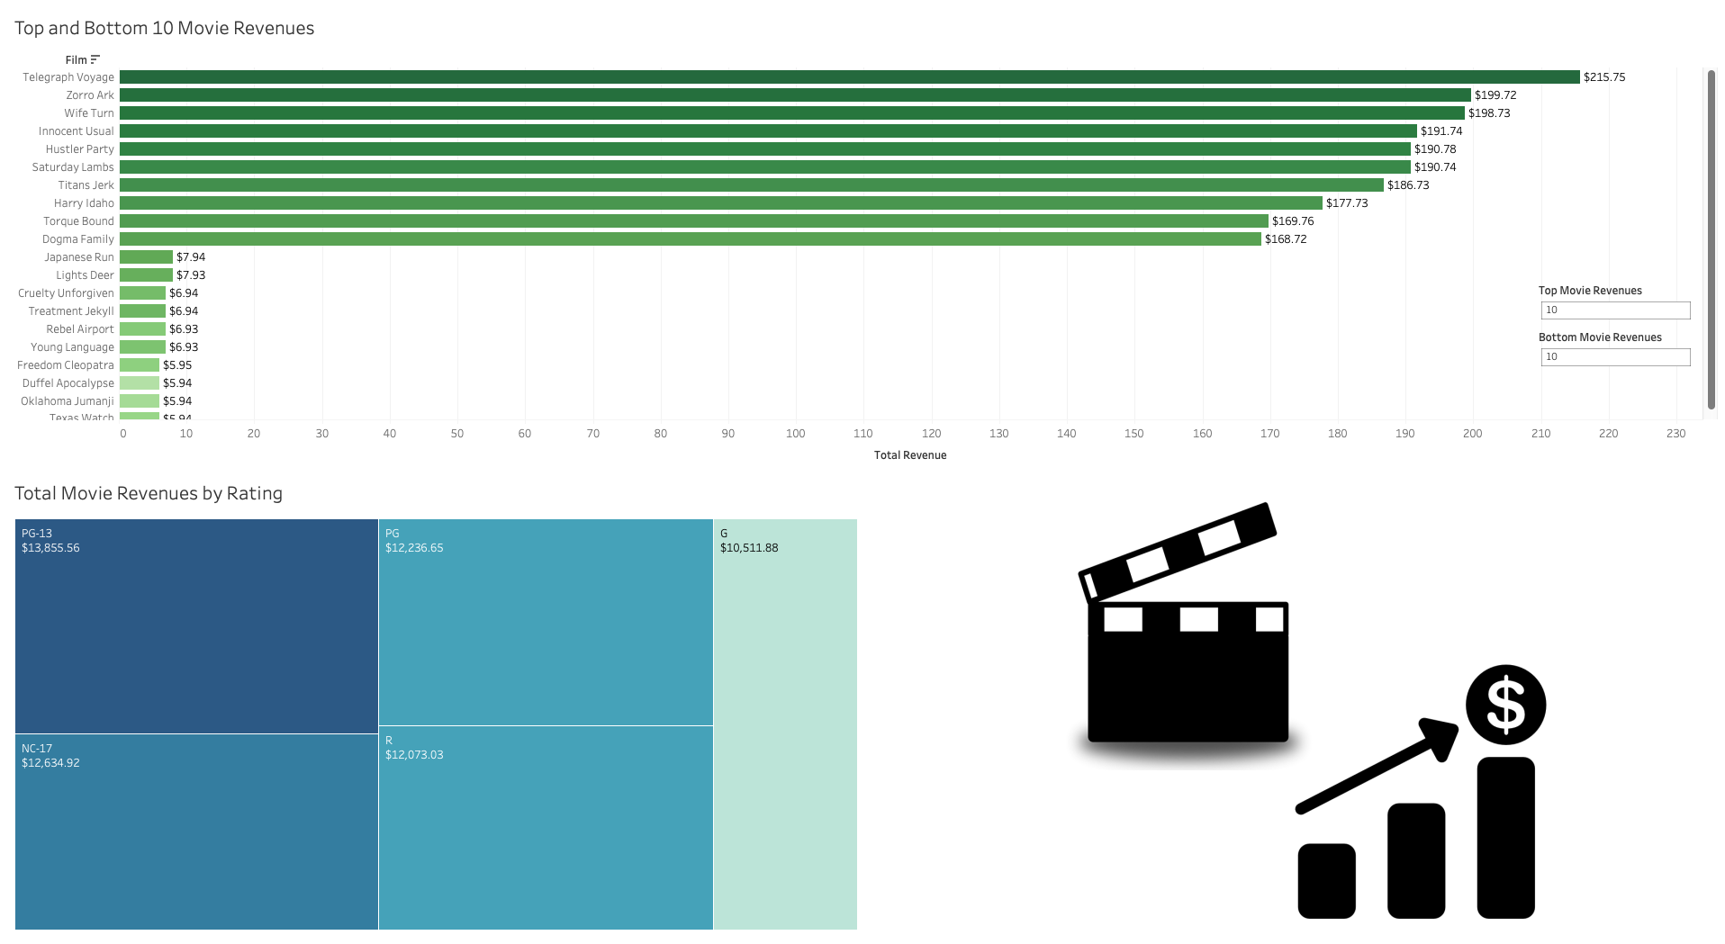
Movie Revenues by Film and Rating

Slide 5
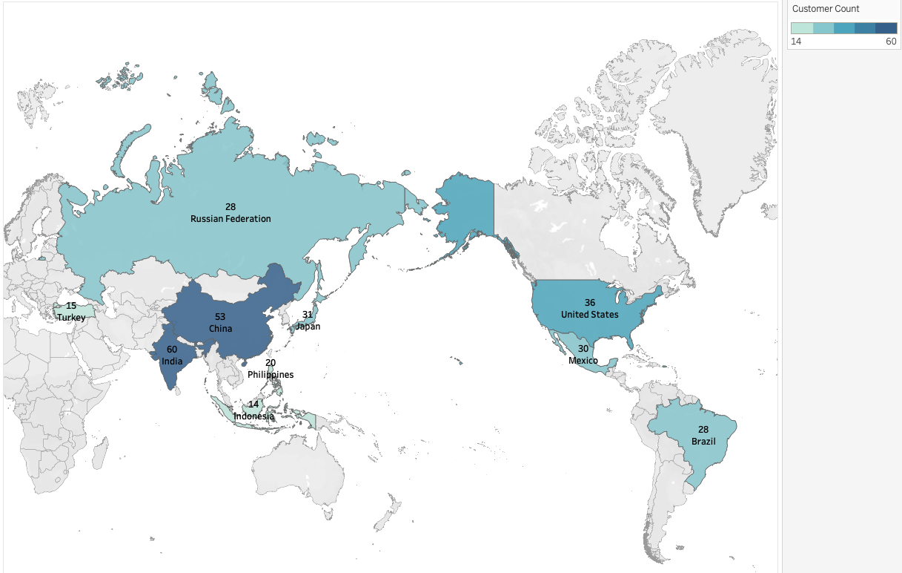
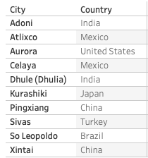
Top 10 Countries by Customer Count
Top 10 Cities in the Top 10 Countries

Slide 6
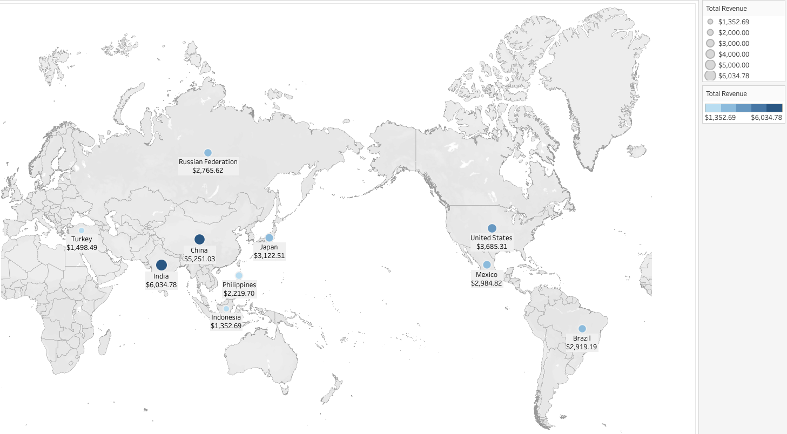
Top 10 Countries by Total Revenue

Slide 7

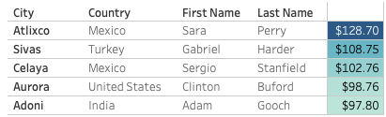

Top Customers
Top 5 Customers within the Top 10 Cities Who Have Paid the Highest Amount

Slide 8
Recommendations
I would recommend focusing most of the attention toward the top revenue countries such as India, China, United States, and Japan
These high revenue countries also have the highest customer counts
It could be helpful to promote the past top selling movies when advertising or using the online rental service itself
Since the service will become online, there will likely be new customers from different locations and a larger variety of movies could be beneficial (ex. Movies made outside of 2006)
Consider adding popular movies not offered on streaming services to give our company the advantage
Link to Tableau: https://public.tableau.com/app/profile/andrew.smith6925

